Slide 1
Introduction To Azure Virtual Network Peering.
Tashik Moin MLSA, Microsoft. Tashik.Moin@StudentAmbassadors.Com
References Microsoft Ignite Microsoft Learn MSDN
Notes:
Good morning! I'm [ YOUR NAME ] and I'm absolutely thrilled to join you in [ CITY YOU ARE IN ].
Azure provides compute, storage and networking for the cloud
If you're new to Azure, or the cloud, it can be intimidating
This session will cover the essential concepts you'll need to get off and running with Azure networking

Slide 2
Virtual Network Peering Within Same Region

Slide 3
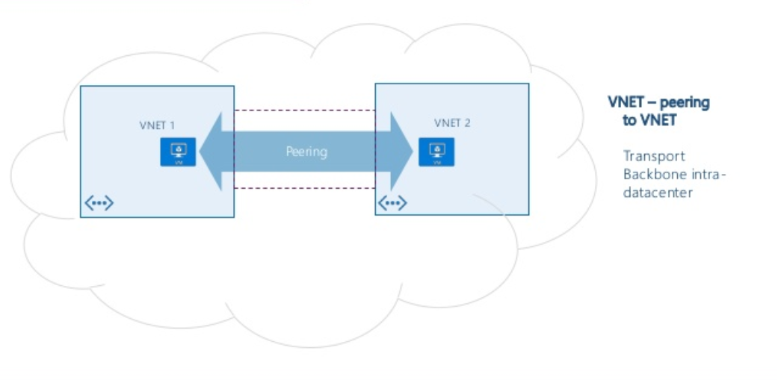

Slide 4
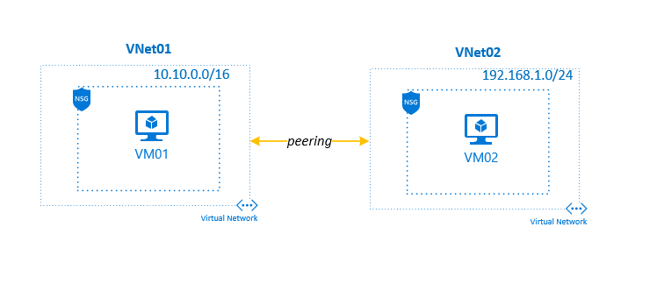
Same Region VNET-Peering

Slide 5
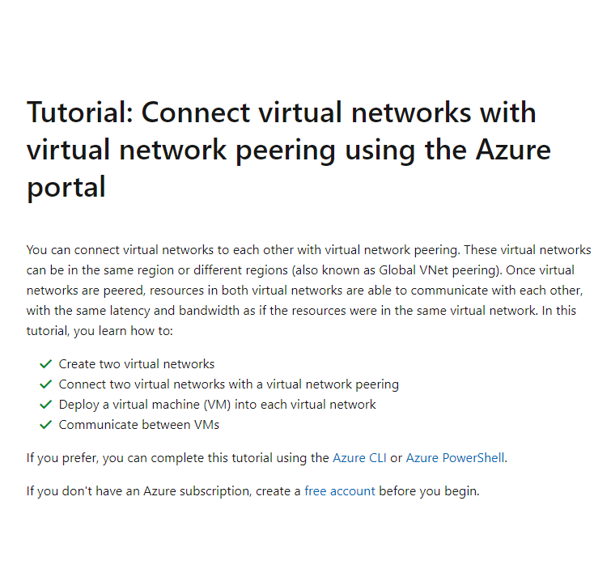

Slide 6
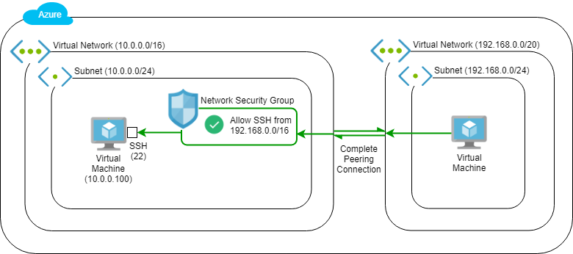

Slide 7
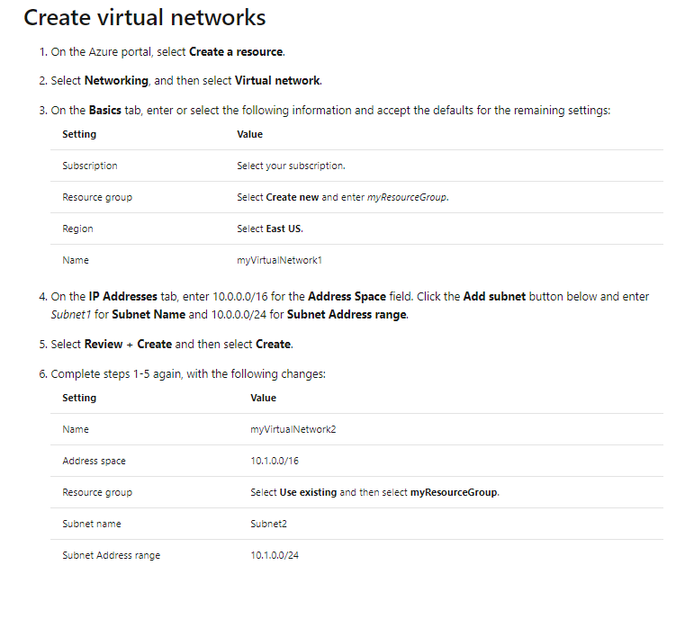

Slide 8
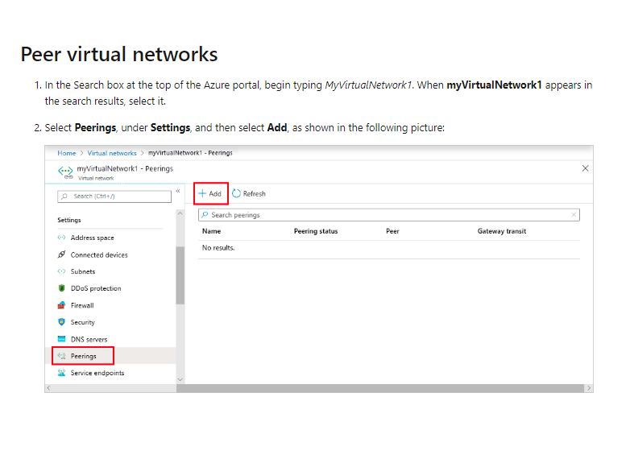

Slide 9
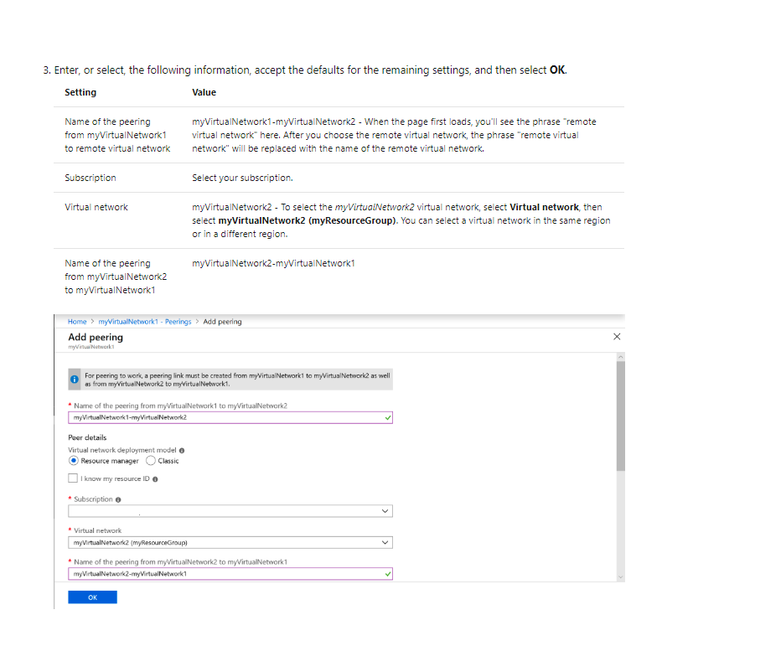

Slide 10
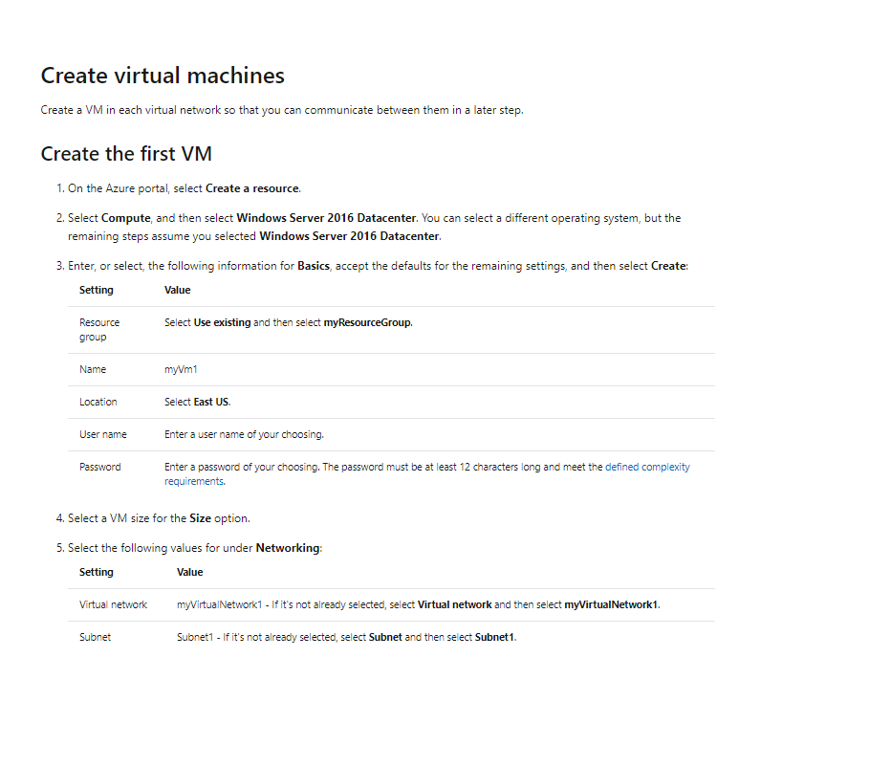

Slide 11
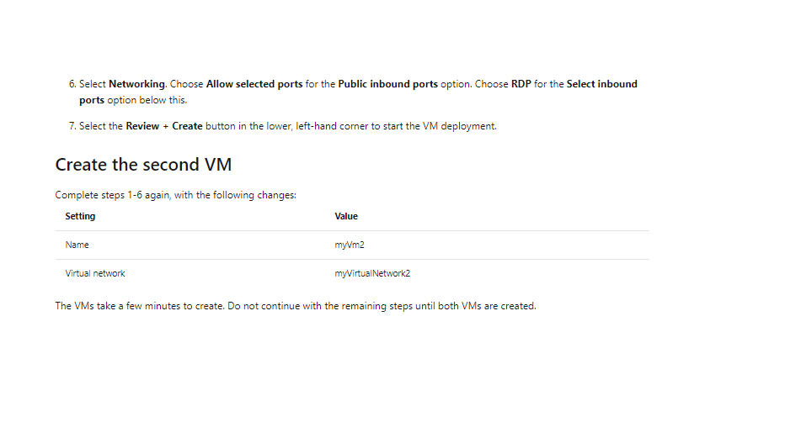

Slide 12
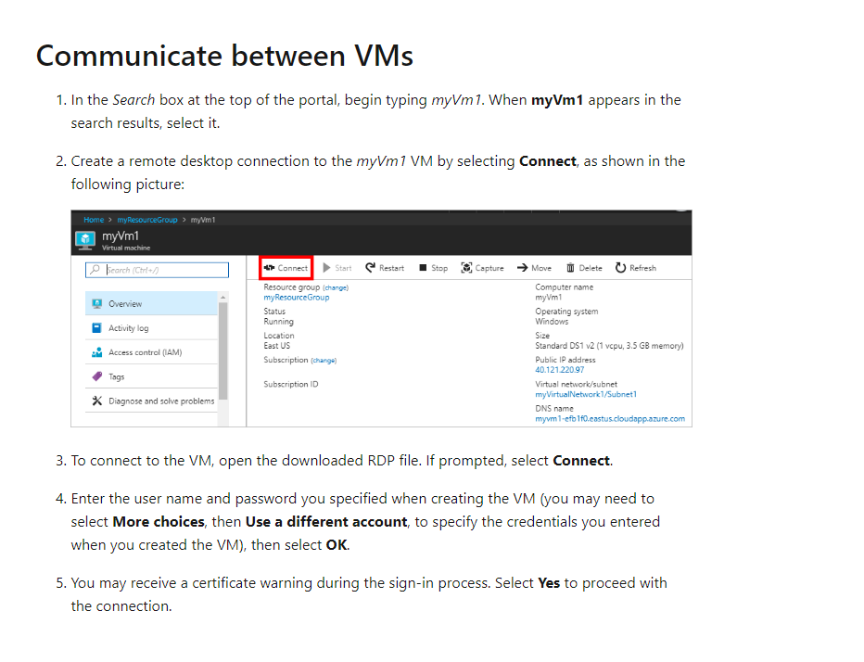

Slide 13
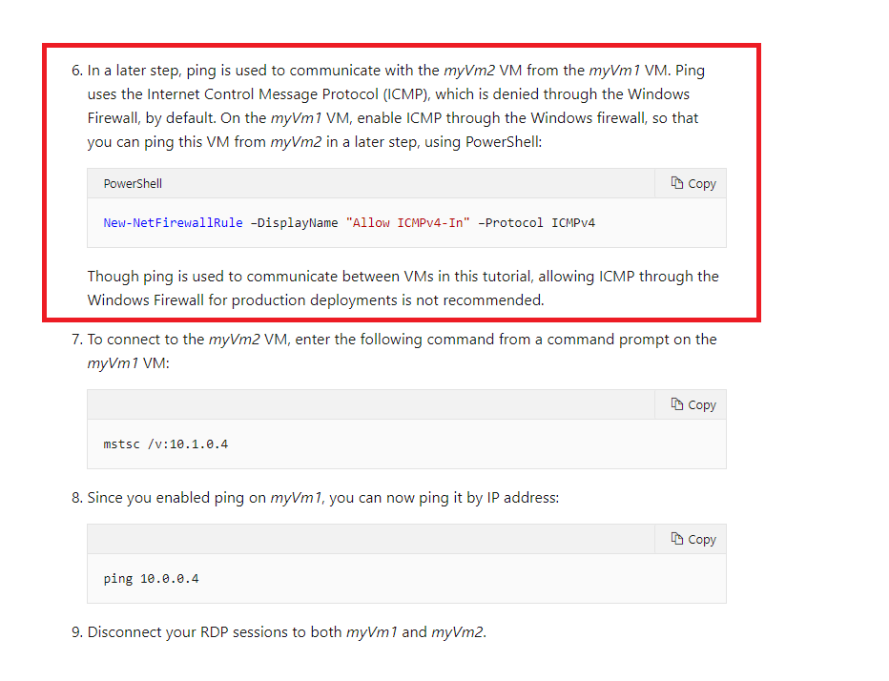

Slide 14
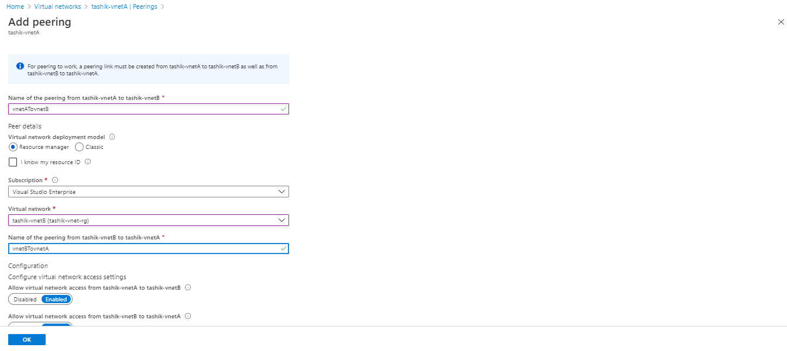

Slide 15
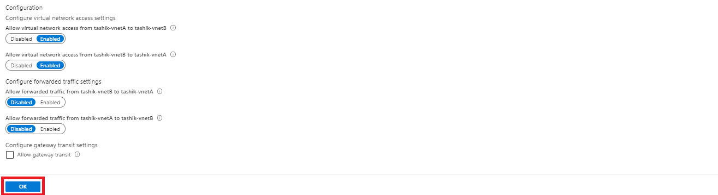

Slide 16
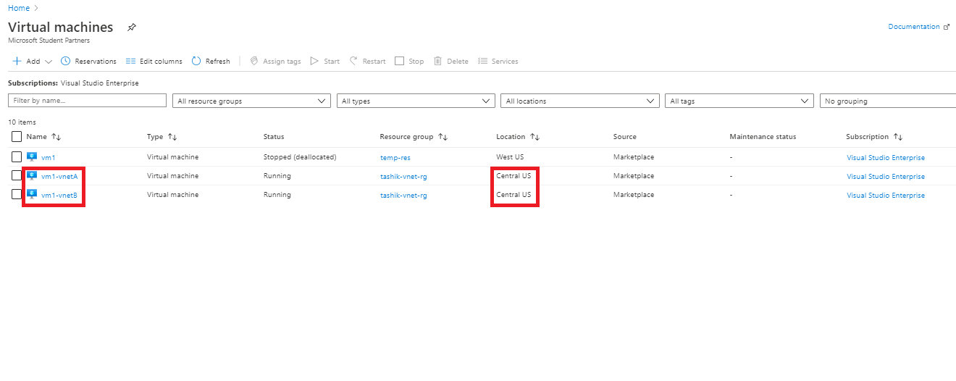

Slide 17
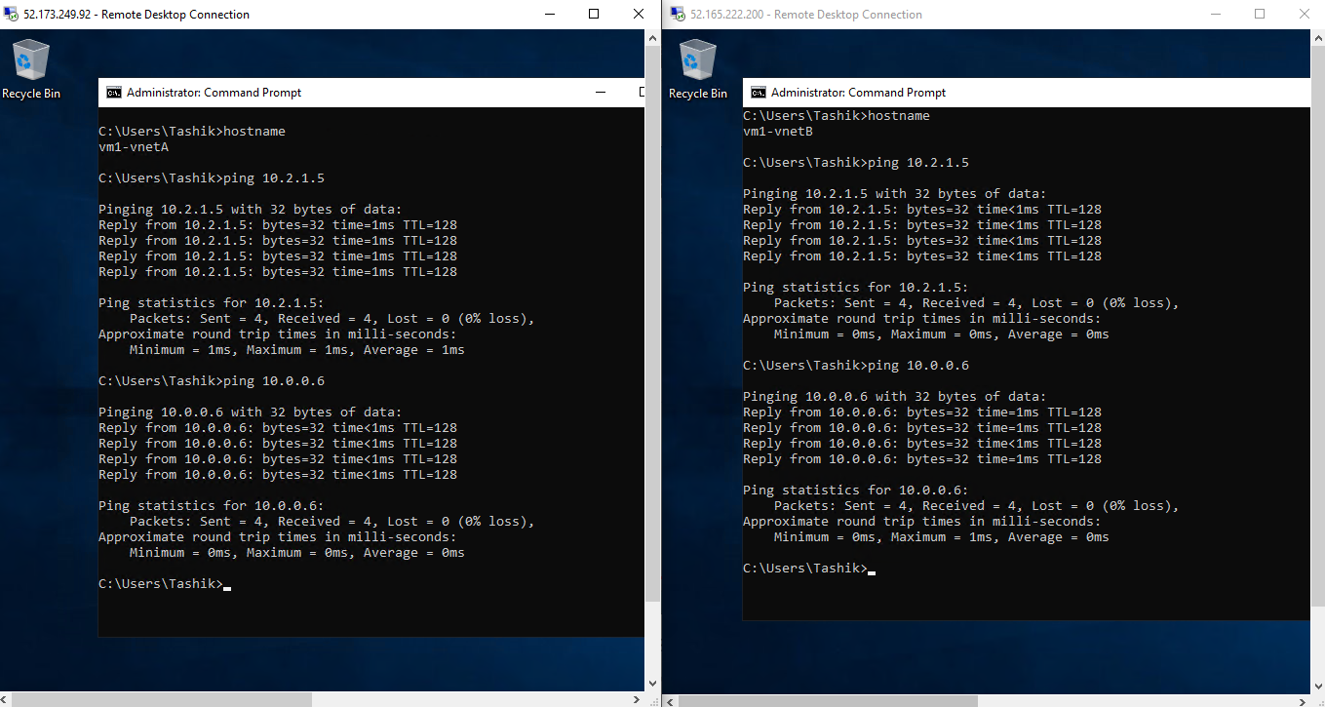
Reply On Both, Self IP Address, VNET-B Virtual Machine IP Address.
Reply On Both, Self IP Address, VNET-A Virtual Machine IP Address.

Slide 18
Global Virtual Network Peering

Slide 19
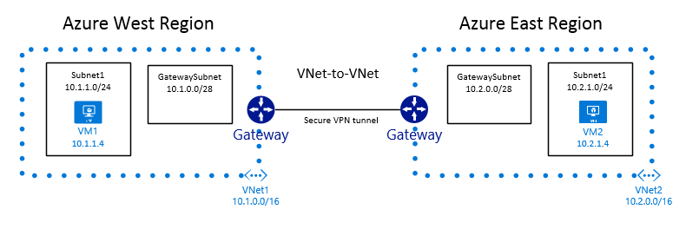

Slide 20
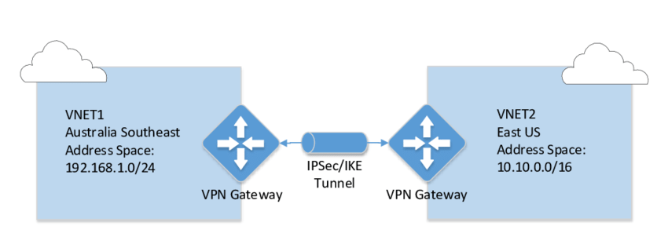
Create 2 Virtual Networks In Two Different Regions For Global Peering.

Slide 21
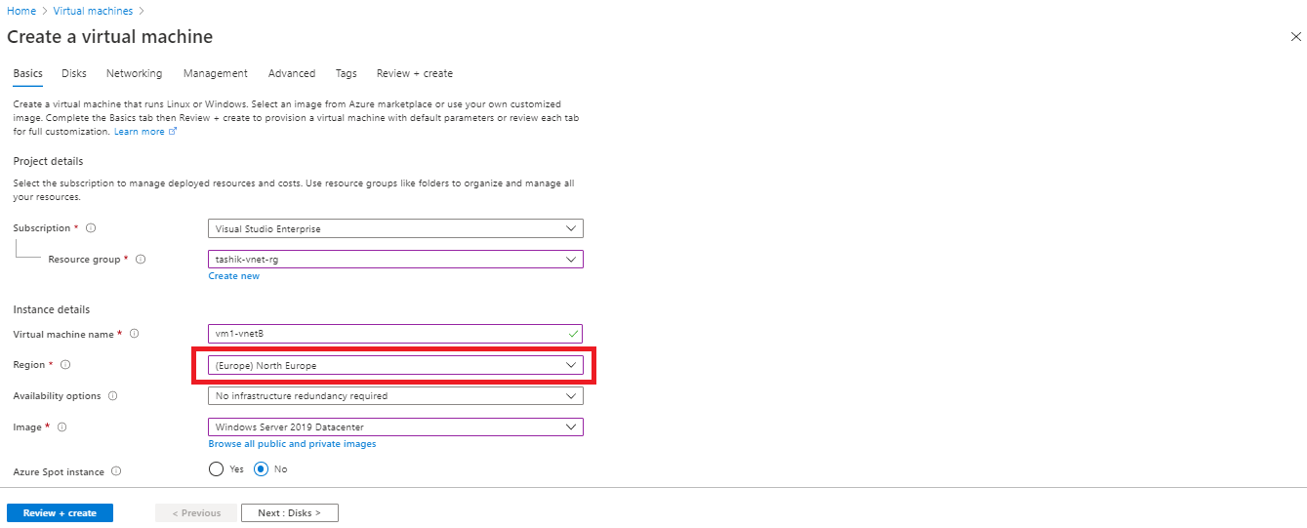
Note: The Resource Group And Region Name For Virtual Machines Should Be Similar To Their Respective Virtual Networks.
Similarly, Create Another Virtual Machine In Second Virtual Network.

Slide 22
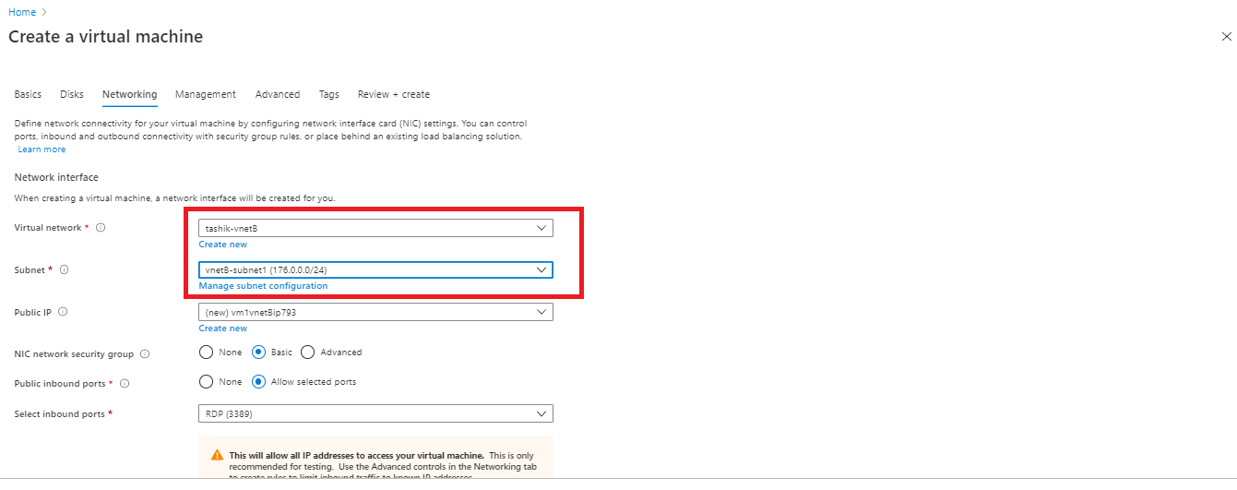
Create 2 Virtual Machines, VM1 → In First Virtual Network. VM2 → In Second Virtual Network.

Slide 23
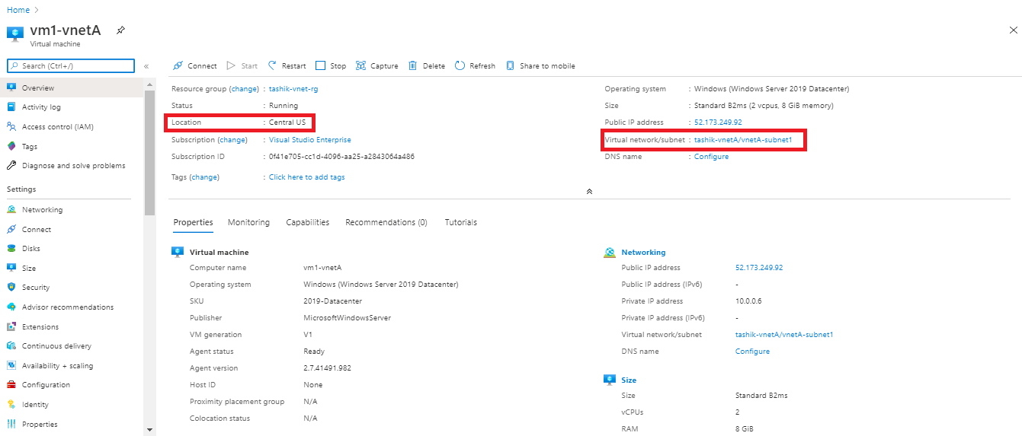

Slide 24
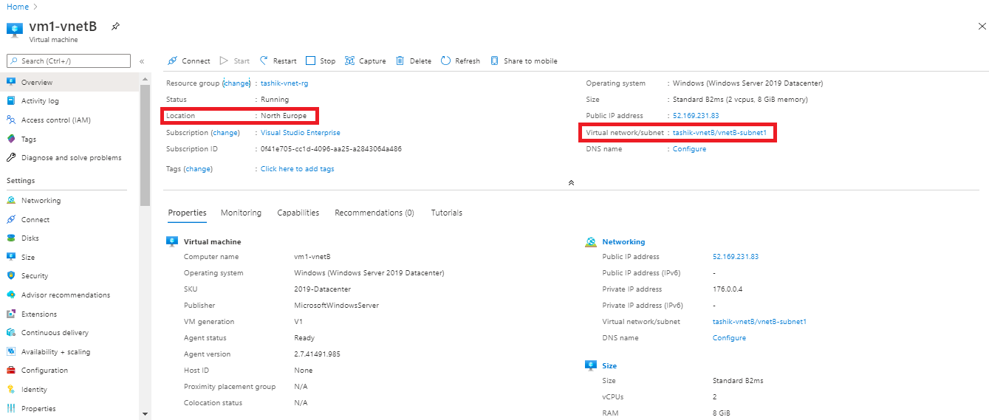

Slide 25
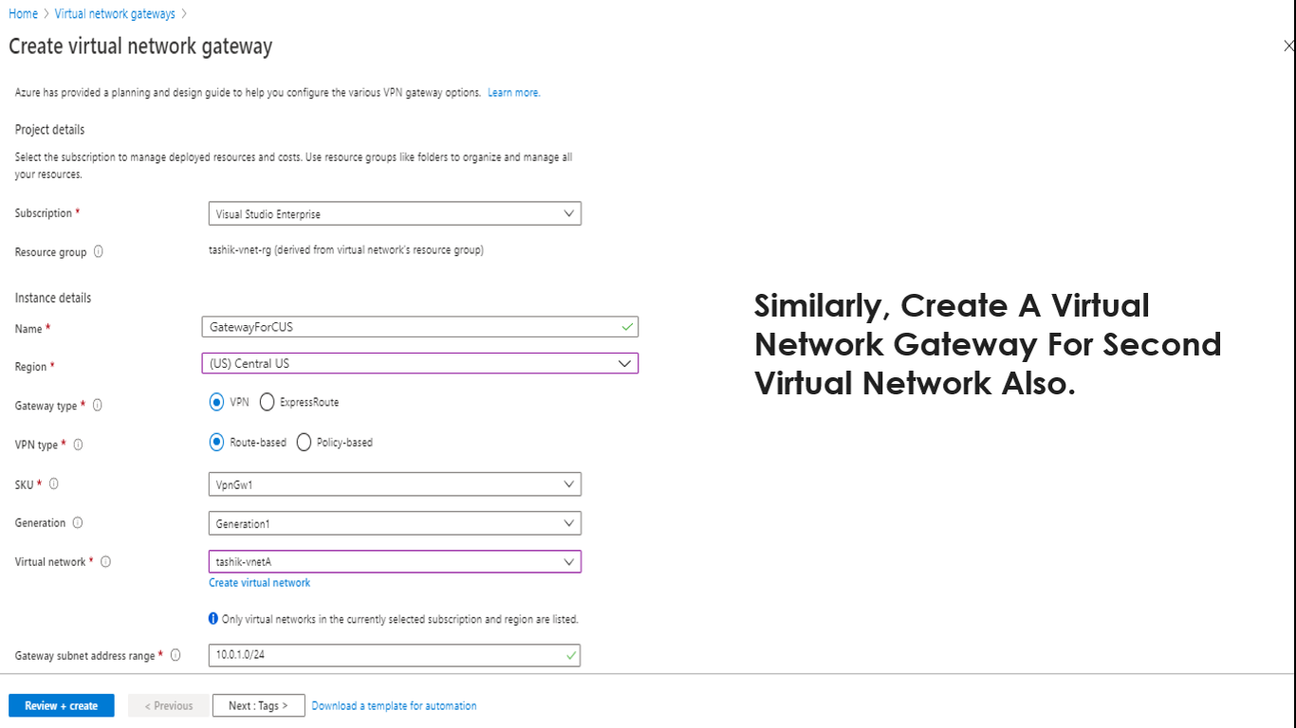
Similarly, Create A Virtual Network Gateway For Second Virtual Network Also.

Slide 26
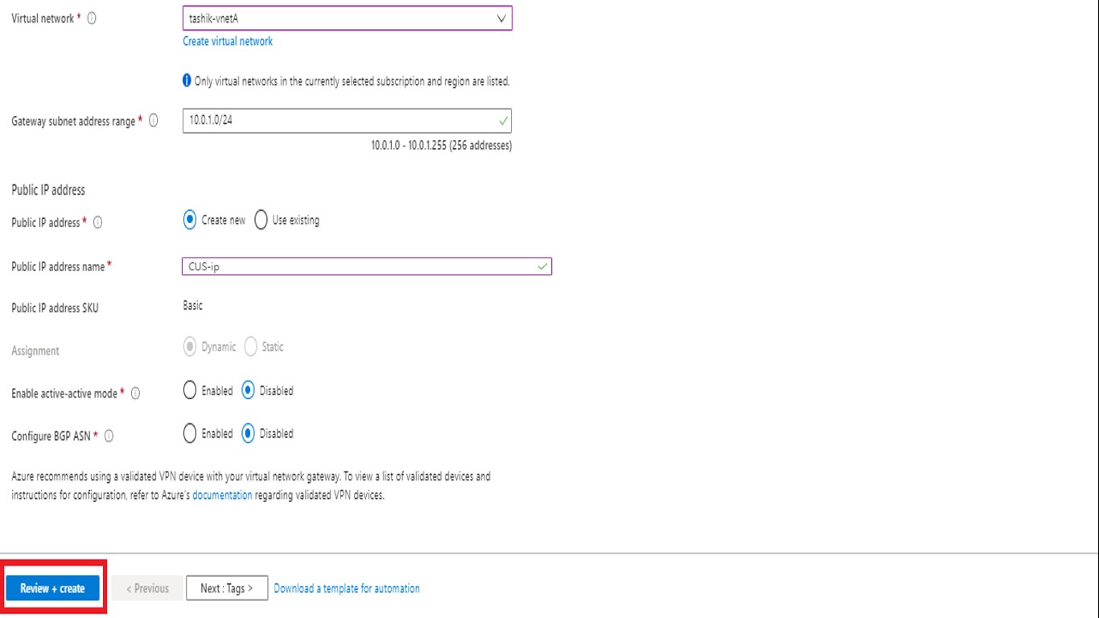

Slide 27
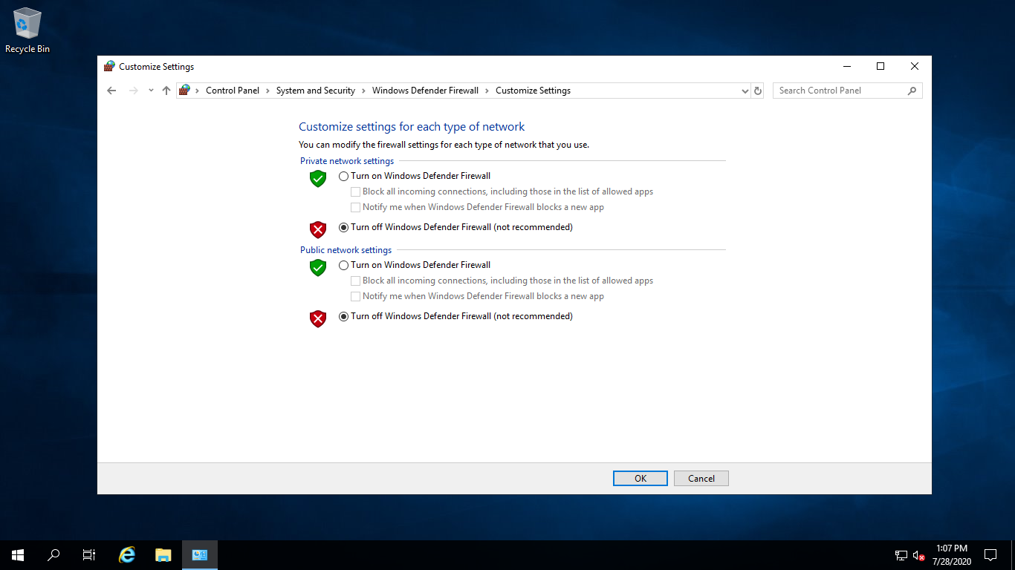
Note: Turn Off The Windows Firewall Of Both The Virtual Machines.

Slide 28
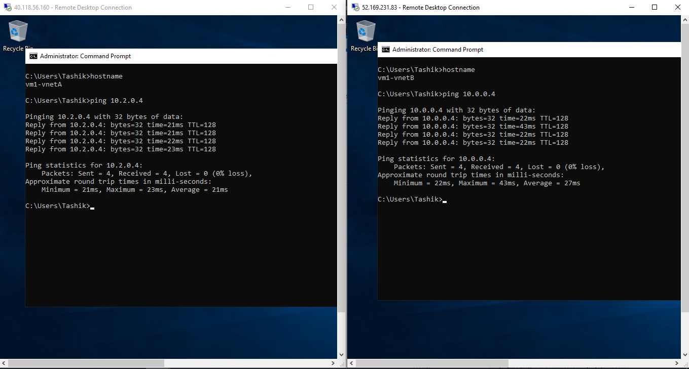

Slide 29
For More Questions/Answers On Virtual Networks For Certification Preparation Do Visit The Link Given Below,
https://docs.microsoft.com/en-us/azure/virtual-network/virtual-networks-faq#security

